Slide 1


PYTHON
Lecture 33

Slide 2

Today’s Agenda
Strings -I
What Is A String ?
Creating A String
Different Ways Of Accessing Strings
Operators Which Work On Strings

Slide 3
What Is A String ?
A Python string is a sequence of zero or more characters.
It is an immutable data structure.
This means that we although we can access the internal data elements of a string object but we can not change it’s contents

Slide 4
How Can Strings Be Created ?
Python provides us 3 ways to create string objects:
By enclosing text in single quotes
By enclosing text in double quotes
By enclosing text in triple quotes (generally used for multiline strings)

Slide 5
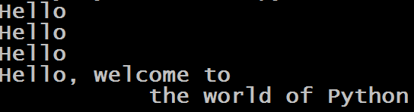
Example
my_string = 'Hello'
print(my_string)
my_string = "Hello"
print(my_string)
my_string = '''Hello'''
print(my_string)
my_string = """Hello, welcome to
the world of Python"""
print(my_string)
Output:

Slide 6
How Can Strings Be Accessed ?
Python provides us 3 ways to access string objects:
Directly passing it to the print( ) function
Accessing individual elements using subscript operator [ ]
Accessing multiple elements using slice operator [ : ]

Slide 7
Printing The Whole String
city="Bhopal"
print(city)
Output:
Bhopal

Slide 8
Accessing Individual Elements
A string in Python has indexes running from 0 to size-1
For example:
city=“Bhopal”
The above code will create a logical diagram in memory, where positive indexing will go from 0 to 5 and negative indexing from -1 to -6

Slide 9
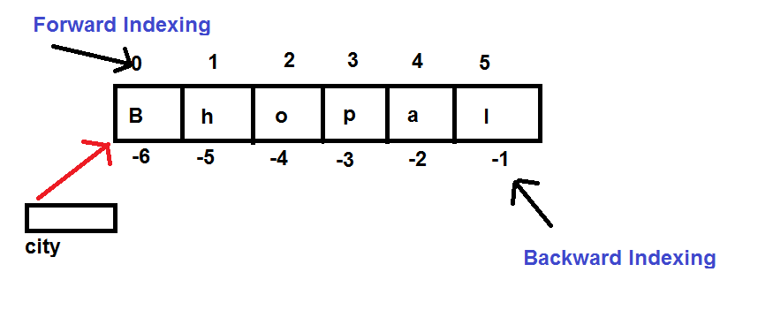
Accessing Individual Elements

Slide 10
Accessing Individual Elements
city="Bhopal"
print(city[0])
print(city[1])
print(city[-1])
print(city[-2])
Output:
B
h
l
a

Slide 11
Guess The Output ?
city="Bhopal"
print(city[6])
Output:
IndexError: String index out of range

Slide 12
Guess The Output ?
city="Bhopal"
print(city[1.5])
Output:
TypeError: String indices must be integers

Slide 13
Accessing String Elements Using while Loop
city="Bhopal"
i=0
while i<len(city):
print(city[i])
i=i+1
Output:
B
h
o
p
a
l
Just like len( ) works with lists and tuple similarly it also works with string returns number of elements in the string

Slide 14
Accessing String Elements Using for Loop
city="Bhopal"
for ch in city:
print(ch)
Output:
B
h
o
p
a
l
Since string is a sequence type , so for loop can iterate over individual elements of the string

Slide 15
Exercise
Redesign the previous code using for loop only to traverse the string in reverse order. Don’t use slice operator

Slide 16
Solution
city="Bhopal"
for i in range(len(city)-1,-1,-1):
print(city[i])
Output:
l
a
p
o
h
B

Slide 17
Slice Operator With String
Just like we can apply slice operator with lists and tuples, similarly Python allows us to apply slice operator with strings also.
Syntax: string_var[x:y]
x denotes the start index of slicing and y denotes the end index . But Python ends slicing at y-1 index.

Slide 18
The Slicing Operator
Example:
city="Bhopal"
print(city[3:5])
Output:
pa
Example:
city="Bhopal"
print(city[1:4])
Output:
hop

Slide 19
The Slicing Operator
Example:
city="Bhopal"
print(city[0:10])
Output:
Bhopal
Example:
city="Bhopal"
print(city[0:4])
Output:
Bhop

Slide 20
The Slicing Operator
Example:
city="Bhopal"
print(city[6:10])
Output:
Example:
city="Bhopal"
print(city[2:2])
Output:

Slide 21
The Slicing Operator
Example:
city="Bhopal"
print(city[:4])
Output:
Bhop
Example:
city="Bhopal"
print(city[1:])
Output:
hopal

Slide 22
The Slicing Operator
Example:
city="Bhopal"
print(city[-2:])
Output:
al
Example:
city="Bhopal"
print(city[:-2])
Output:
Bhop

Slide 23
The Slicing Operator
Example:
city="Bhopal"
print(city[-2:-2])
Output:
Example:
city="Bhopal"
print(city[-2:1])
Output:

Slide 24
The Slicing Operator
Example:
city="Bhopal"
print(city[-2:5])
Output:
a
Example:
city="Bhopal"
print(city[-2:2])
Output:

Slide 25
The Slicing Operator
Example:
city="Bhopal"
print(city[1:-2])
Output:
hop
Example:
city="Bhopal"
print(city[-4:3])
Output:
o

Slide 26
Using Step Value
String slicing can accept a third parameter also after the two index numbers.
The third parameter is called step value.
So the complete syntax of slicing operator is:
s[begin:end:step]
Step value indicates how many characters to move forward after the first character is retrieved from the string and it’s default value is 1 , but can be changed as per our choice.

Slide 27
Using Step Value
Another point to understand is that if step is positive or not mentioned then
Movement is in forward direction ( L→R)
Default for start is 0 and end is len
But if step is negative , then
Movement is in backward direction (R→L)
Default for start is -1 and end is –(len+1)

Slide 28
The Slicing Operator
Example:
city="Bhopal"
print(city[1:4:0])
Output:
ValueError: Slice step cannot be 0
Example:
city="Bhopal"
print(city[1:4:2])
Output:
hp

Slide 29
The Slicing Operator
Example:
city="Bhopal"
print(city[4:1:-1])
Output:
apo
Example:
city="Bhopal"
print(city[4:1:1])
Output:

Slide 30
The Slicing Operator
Example:
city="Bhopal"
print(city[::-1])
Output:
lapohB
Example:
city="Bhopal"
print(city[::])
Output:
Bhopal

Slide 31
The Operators With Strings
There are 6 operators which work on Strings:
+ : For joining 2 strings
* : For creating multiple copies of a string
in : For searching a substring in a string
not in: Opposite of in
Relational Operator : For comparing 2 strings
Identity Operators : For comparing addresses

Slide 32
The Operator +
The + operator concatenates strings. It returns a string
consisting of the operands joined together
Example:
a="Good"
b="Morning"
c="User"
print(a+b+c)
Output:
GoodMorningUser

Slide 33
The Operator *
The * operator creates multiple copies of a string.
Example:
a="Bye"
print(a*2)
print(2*a)
Output:
ByeBye
ByeBye

Slide 34
Guess The Output ?
a="Bye"
print(a*0)
print(a*-2)
Output:
The * operator allows it’s operand to be negative or 0 in which case it returns an empty string

Slide 35
Guess The Output ?
x="Ba"+"na"*2
print(x)
Output:
Banana

Slide 36
The Operator in
The in operator returns True if the first operand is contained within the second, and False otherwise:
Example:
a="banana"
print(“nana” in a)
print(“nani” in a)
Output:
True
False

Slide 37
The Operator not in
The not in operator behaves opposite of in and returns True if the first operand is not contained within the second, and False otherwise:
Example:
a="banana"
print(“nana” not in a)
print(“nani” not in a)
Output:
False
True

Slide 38
The Relational Operators
We can use ( > , < , <= , >= , == , != ) to compare two strings.
Python compares string lexicographically i.e using Unicode value of the characters.
Example:
"tim" == "tie"
"free" != "freedom"
"arrow" > "aron"
"right" >= "left“
"teeth" < "tee"
"yellow" <= "fellow"
"abc" > " "
Output:
False
True
True
True
False
False
True

Slide 39
The Identity Operators
‘is’ operator returns True if both the operand point to same memory location.
’is not’ operator returns True if both the operand point to different memory location.
Example:
a = 'London'
b = 'London'
c = 'Paris'
print(a is b)
print(a is c)
print(b is c)
print(b is not a)
print(b is not c)
Output:
True
False
False
False
True

